Slide 1
Computer Graphics and Image Processing
Color II

Slide 2
Outline
Recap: Human Perception of Color
Color Spaces
RGB
CIE XYZ
HLS

Slide 3

Human Perception of Color

Slide 4
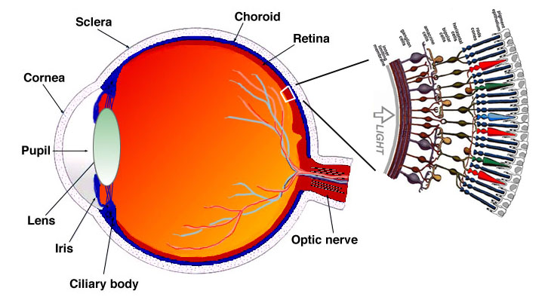
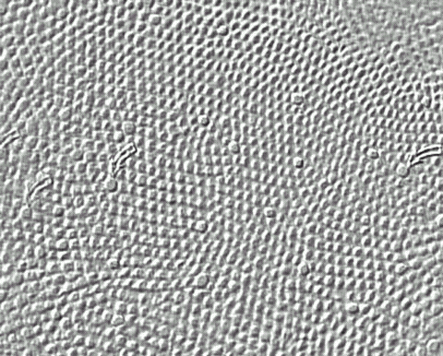
The Eye
Four types of receptors (sensors): R/G/B cones + rods, each has unique SRF
http://webvision.med.utah.edu/imageswv/fovmoswv.jpeg
http://webvision.med.utah.edu/imageswv/Sagschem.jpeg

Slide 5
Seeing Red, Green and Blue
A cone cell in the retina measures amount of red, green, or blue wavelength energy (3 SRF’s). Responds only in bright light.
SRF of a rod cell covers all wavelengths (measures “gray level” or intensity) Responds in low light, but not in bright light.
Integral of R, G, or B cone response produces a single value Note: SRF’s really L, M, S wave responses (long, medium, short), not R, G, B. Note: low response of short (blue) is scaled up by vision system (after retina).
=
=
SDF of source
Short (blue)
(scaled)
Χ
=
=
Medium (green)
SRF’s of eye (L, M, S)
=
=
Long (red)
© 2004 Lewis Hitchner, Richard Lobb & Kevin Novins

Slide 6
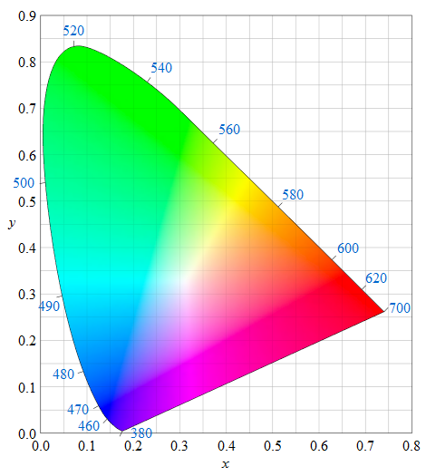
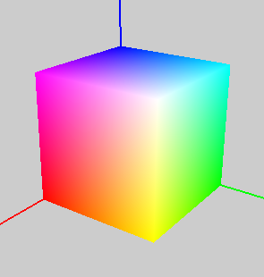
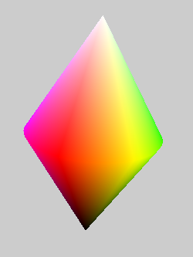

Color Spaces
CIE image thanks to Sakurambo

Slide 7
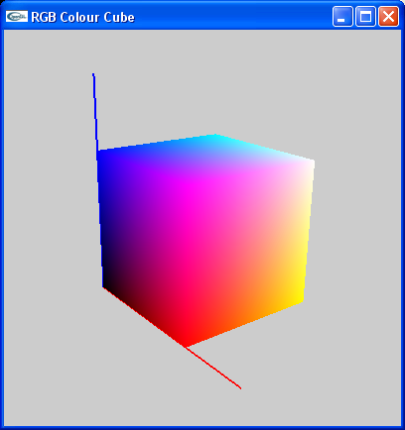
Color Coordinate Space
Defines 3 SRFs (color matching functions) for some sensing system
One dimension for each SRF (→ tristimulus color space)
Each dimension represents a primary color P
Coordinate value = resulting SDF integral normalized to (0, 1)
Color triple is 3D point defined by chromaticity values (c₀, c₁, c₂)
Example: RGB color space
Primaries: Red, Green, Blue with basis vectors R = (0,0,1) G = (1,0,0) B = (0,1,0)
Chromaticity values: (r,g,b) = r (R) + g (G) + b (B)
Blue
Cyan
RGB “color cube”
White
Magenta
Green
Yellow
Red

Slide 8
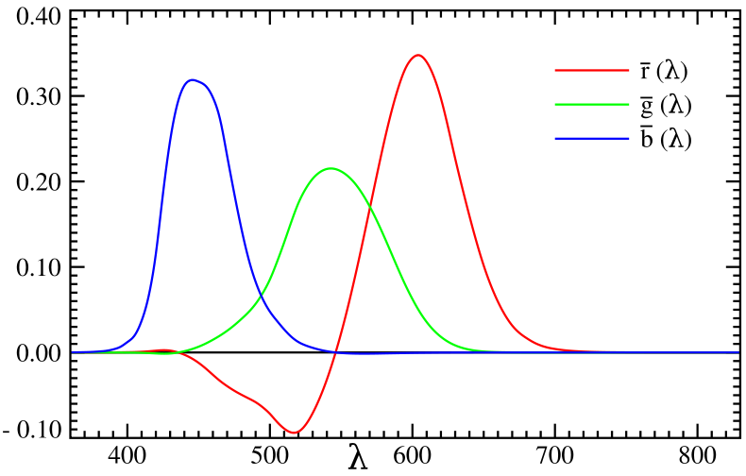
Finding Color Matching Functions
Given: 3 primaries A, B, C
Wanted: 3 SRFs, one for each primary
Idea:
Show light L with pure color of wavelength λ and brightness 1 to test persons
Let them adjust another light P using chromaticities a, b, c until L and P match
Do this with the whole range of wavelengths λ and note down the a, b, c values for each λ
Problem: when using normal, visible colors as primaries, some wavelengths λ need negative chromaticities (because adding colors decreases saturation)
A
C
B

Slide 9
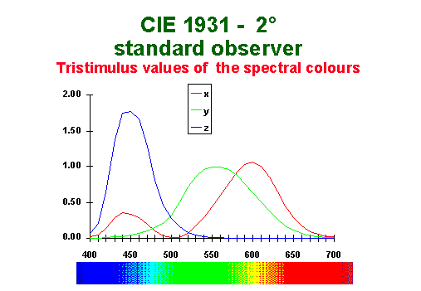
CIE XYZ Color Space (1931)
A normalized, standard color space designed by engineers according to requirements:
Standard primaries (“R”, “G”, “B”)
Only positive chromaticities
Equal chromaticities are grays
Easy conversion to brightness levels
Three primaries: X, Y, Z
All are “imaginary” (not real colors)
SRFs were designed by engineers to meet above requirements
Y corresponds to brightness
Conversion to RGB is a matrix multiply (linear combination of X,Y,Z = R,G,B and vice versa)

Slide 10
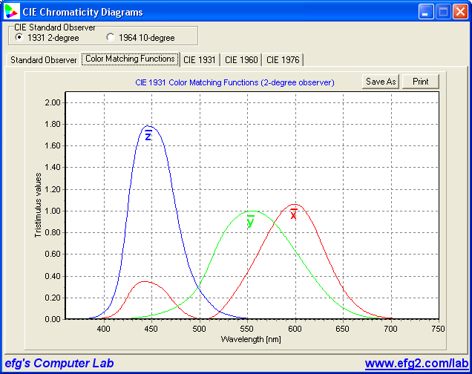
CIE XYZ Color Matching Functions
(X,Y,Z) coordinates of any input SDF are found by multiplying and integrating
This defines the (X,Y,Z) color of the SDF

Slide 11
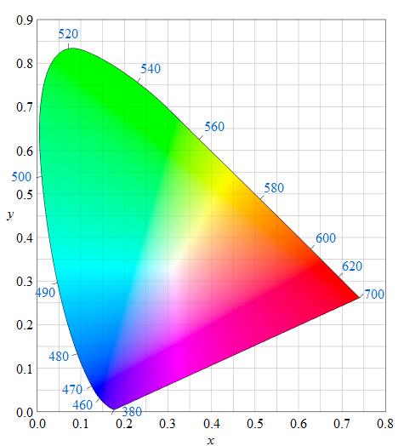
CIE Chromaticity Diagram
2D Chromaticity Space:
Projection of 3D XYZ space onto 2D plane x + y + Z = 1
Looking only at colors with brightness 1
2D coordinates (x,y) defined as:
Pure spectral colors lie on curve (“spike” SDF at a single λ)
Increasing λ
(x,y) is the chromaticity of the color

Slide 12
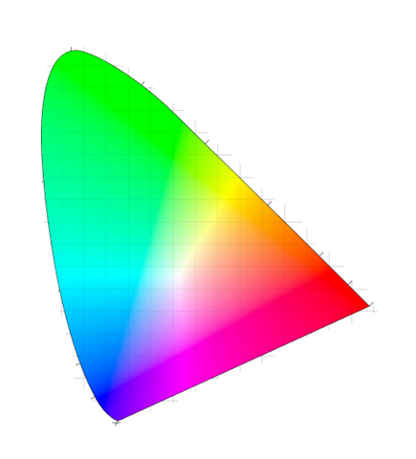
CIE Chromaticity Diagram
y
Pure spectral colours
All mixes of colours A and B lie on this line
Spectral colour B
Spectral colour A
All possible colours!
700 nm
380 nm
x

Slide 13
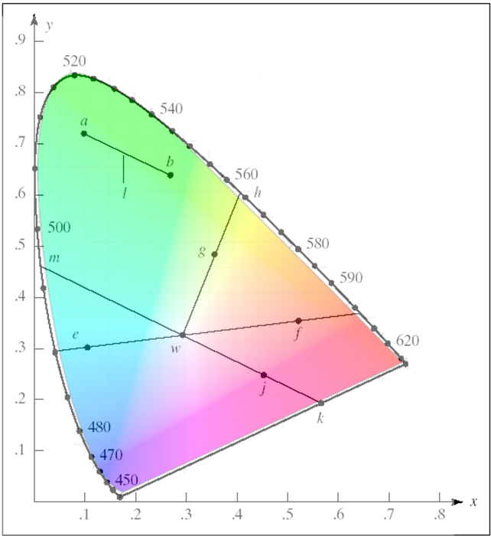
Using the CIE Chromaticity Diagram
w is white
e and f are complementary colors (→ can be combined to white)
h is dominant wavelength of g
wg / wh is saturation of g (→ how close in % g is to its pure color)

Slide 14
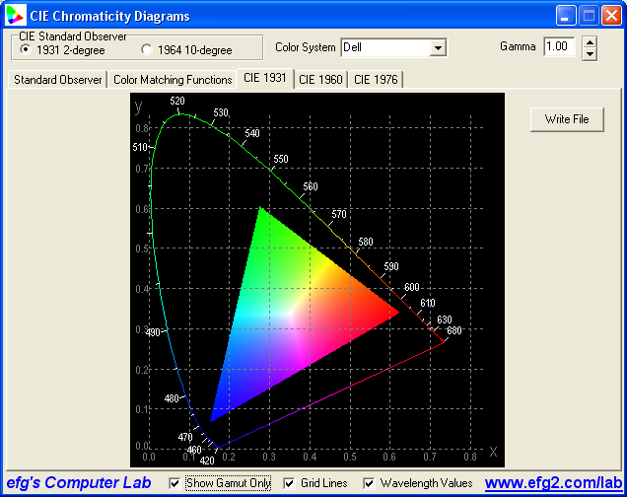
Color Gamut
Subset of colors that can be represented on a device
CIE color space can be used to describe color gamut
Measure maximum intensity of each device primary in CIE (use filters with SRF’s = CIE SRF’s)
Convert to (x,y) chromaticity
2D triangle defines possible device colors (→ color gamut)
Different devices have different gamuts (→ problem of color conversion)
gamut of another device
max. green
max. blue
max. red

Slide 15
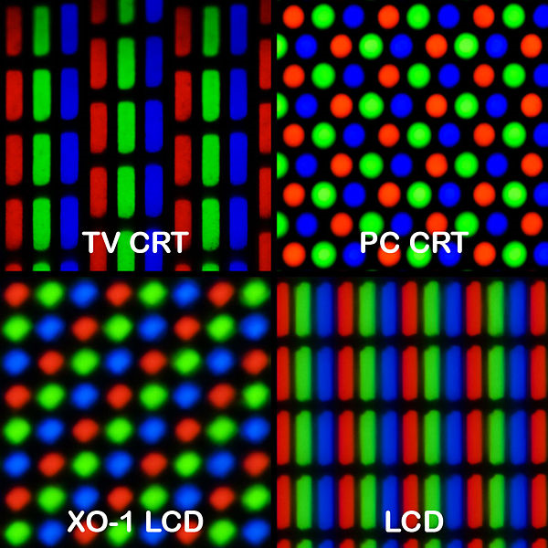
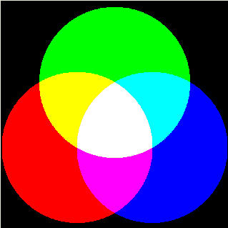
Additive Color Systems
Colors are mixed by adding up appropriate amounts of primaries (adding SDF spikes to black)
Widely used in screens with subpixels that emit R,G,B
Cones in retina respond to light emitted by each subpixel
Brain adds the individual cone responses to produce perception of hue, luminance, and saturation
→ Demo program: ColorMix.exe http://www.efg2.com/Lab/Graphics/Colors/ColorMix.htm
Top image thanks to Pengo

Slide 16
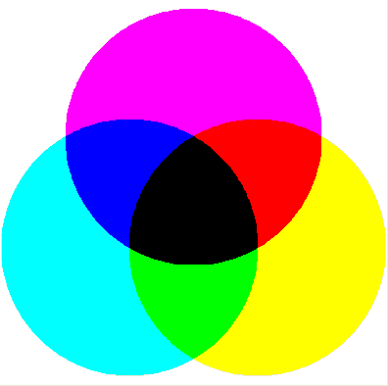
Subtractive Color Systems
Colors are mixed by subtracting appropriate amounts of colors from white (like using notch SRFs on white)
White light is reflected or transmitted, and some wavelengths are absorbed (subtracted), e.g. colored glass, printed images
The colors to substract are the complements of the primaries, e.g. cyan, magenta, yellow (CMY)
Cyan absorbs red
Magenta absorbs green
Yellow absorbs blue
CMYK (K = black) often used for 4 colour printers

Slide 17
Troubles with RGB
Difficult to use for color design because selecting a hue sometimes not intuitive, e.g. what combination of RGB do you use to make brown? (128, 80, 50) is a good choice. Could you figure that out?
Not a good color space for interpolating between colors
For example, ½ blue + ½ white = ½ magenta + ½ cyan =
Linear interpolation between (r,g,b) chromaticities does not linearly interpolate the saturation or the luminance
Blue
Cyan
White
Magenta
Green
Yellow
Red
© 2004 Lewis Hitchner, Richard Lobb & Kevin Novins

Slide 18
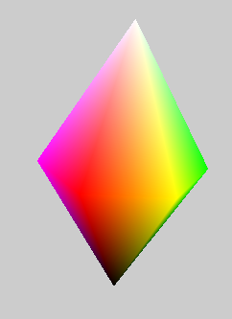
HLS Color Space
Hue, Lightness, Saturation
Based on transformation of RGB cube → double “hexcone”→ double cone

Slide 19
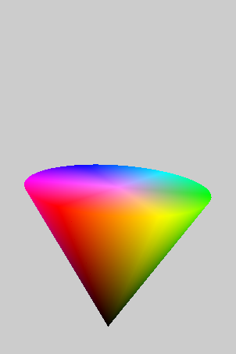
HLS Color Space
Hue
H
S
L
Saturation (lightness = 50%)
Lightness (saturation = 50%)

Slide 20
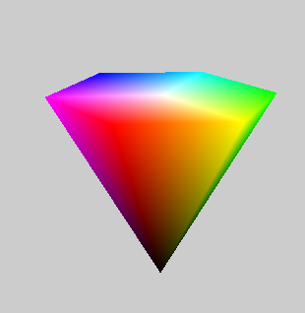

HSV Color Space
Hue, Saturation, Value (similar to Lightness)
Only single cone: at the top all colors are brightest
V
(value)

Slide 21
Colour interpolation: RGB vs HLS
Linear interpolation between 2 RGB colors in RGB space: C₀ = (r₀, g₀, b₀) ⇨ C₁ = (r₁, g₁, b₁)
r(t) = r₀ + t (r₁ - r₀), g(t) = g₀ + t (g₁ - g₀), b(t) = b₀ + t (b₁ - b₀) 0 <= t <= 1
Problem: saturation and luminance are not linearly interpolated. Interpolation may correctly vary from one hue to another, but S and L may vary in strange ways!
Linear interpolation between 2 HLS colors in HLS space: C₀ = (h₀, l₀, s₀) ⇨ C₁ = (h₁, l₁, s₁)
h(t) = h₀ + t (h₁ - h₀), l(t) = l₀ + t (l₁ - l₀), s(t) = s₀ + t (s₁ - s₀) 0 <= t <= 1
All 3 components (HLS) linearly interpolated
Solution: Convert C₀, C₁ to HLS; interpolate in HLS, convert results back to RGB
© 2004 Lewis Hitchner, Richard Lobb & Kevin Novins

Slide 22
Summary

Slide 23
Summary
Colors can be represented using a 3D color space
RGB: easy to use for additive color mixing, but limited gamut
CIE can represent all visible colors
HSL can linearly interpolate properly between hue, saturation and lightness
References:
Color Description: Hill, Chapter 11.2
CIE Color Model: Hill, Chapter 11.3
Other Color Spaces: Hill, Chapter 11.4

Slide 24
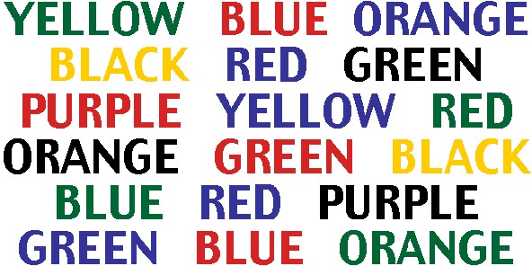
Quiz
What is a color coordinate space?
Name an advantage of the CIE color model.
What is a color gamut?
What are the disadvantages of RGB?
Say the color of the word (not the word itself)

